Slide 1
DEALING WITH ANXIETY: Nurturing Resiliency in Children and Youth
MULGRAVE SCHOOL
PRESENTER:
March 4th 2015 James Skinner
ADLER CENTRE
230-1818 W Broadway Vancouver, V6J1Y9 phone: 604 742 1818

Slide 2
WHAT IS ANXIETY?
Anxiety creates a false picture of the world
Excessive concern: performing, significant self-consciousness.
Believe they don’t have the skills necessary to cope with a threat.
THEY BELIEVE THEY DON’T HAVE CONTROL OR ARE LOSING CONTROL

Slide 3
So What Causes Anxiety?
Involves both nature and nurture.
We are all born with two fears – sudden noises and falling
Most are learned fears
Epigenetics – trauma passed on from biological parents
The FEAR of not BELONGING

Slide 4
Fear is usually about external objects or situations. Anxiety is more internal. Can’t often specify what they are anxious about

Slide 5
Thinking behind Anxiety
That others have standards I can’t meet
The GAP between personal expectation and expectation prior to the event. (perfectionionist)
Wanting to know the outcome before the event.
Fear is at the root of anxiety.
Fear is a mistaken thought that you can’t handle a situation.
Turning the situation into an irrational thought, “I must or I should be able to ……….”

Slide 6
“I don’t think I am able to do it.”

Slide 7
Types of Anxiety
General Anxiety Disorder: out of the blue, can seriously hamper school work, social relationships, daily life
Obsessive-Compulsive Disorder: Also a debilitating anxiety. Negative repetitive thoughts
Panic Disorder: panic attacks, overpowering fear, fear of it happening again.

Slide 8
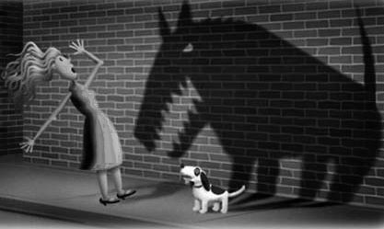
Phobias
Unrealistic and intense fear of; snakes, spiders, or open spaces
Social Phobias: an excessive fear of specific object or situation that is not harmful normally
Agoraphobia: students do not participate in social situations
Posttraumatic Stress Disorder: a traumatic event
Separation Anxiety Disorder: normal for preschoolers, tends to fade with time.

Slide 9
ADLER SAYS:
“The purpose of life is not perfection but wholeness”

Slide 10
“Anxiety is fear
about the Future”
Eric Fromm

Slide 11
Purpose of Anxiety
Anxiety is the fear of being proven worthless or fear of defeat. Not belonging.
Perfectionism is often an element in feelings of anxiety.
“I’m never good enough to BELONG”

Slide 12
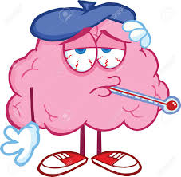
BELONGING
“We are hardwired to belong.”
Daniel Goldman
“ The brain is a social organ, it grows and changes when it interacts with other brains.” Nancy Graham

Slide 13
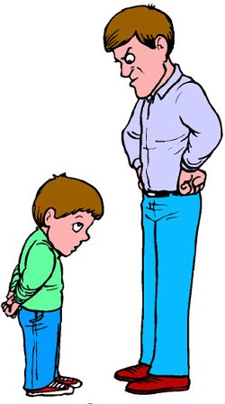
BELONGING
Adlerian’s believe that every child is born with the need to belong…..to feel worthwhile and significant.
As children we are ‘dwarfs amongst giants’ and feel inferior. ‘Inferiority’ is a belief that runs counter to that of ‘belonging’.
In the words of Alfred Adler, "We all choose to belong.

Slide 14
A Story of Belonging
… then we create ‘a story/a Fiction’ of what we believe will help us belong, and then we strive to achieve that mistaken belief.

Slide 15
THE FOUR TASKS OF LIFE
WORK -> SCHOOL
FRIENDSHIP -> PEERS
LOVE RELATIONSHIPS -> FAMILY (TEENS:GIRL/Boy RELATIONSHIPS)
SELF DEVELOPMENT -> INSIGHT, SPIRITUALITY

Slide 16
THE VERTICAL VERSUS THE HORIZONAL
Striving to superiority
Avoiding feelings Inferiority

Slide 17
The Vertical Mode, each striving to overcome feelings of inferiority in order to achieve superiority at the top.

Slide 18
Social Interest is:
“Community feeling” or the “Capacity to “Care about the Cares of Others”

Slide 19
The Horizontal
Move from ME to WE
“What can I bring to the Life Task?”
THE TASKS OF LIFE: WORK, FRIENDSHIP, LOVE, SELF-DEVELOPMENT
Move from Me to We
What can I bring to the Task?

Slide 20
ADLERIANS
Support the values and process of:
Mutual Respect: Firm and Kind at the same time
Cooperation rather than competition
Social Interest: the capacity to Care about the cares of others). Developing community feeling.
Consequences: Natural and Logical
Encouragement
Contribution
Feeling Capable
Consequences: Natural and Logical

Slide 21
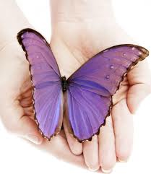
Adler’s Path to Transformation
Acknowledgement and acceptance of ones imperfections. “The Courage to be Imperfect”
The language of praise is replaced by the language of encouragement
The locus of control goes from external to internal
The mind set is the move from “me” to “we”

Slide 22
Daniel Siegel says:
“ The brain in each life situation decides whether the situation is safe or dangerous. If the situation is dangerous it will trigger a fight, flight or freeze mode. This inhibits learning.”
“If the situation is deemed safe the safety mechanism is triggered (love without fear) which allows the student to sustain focus.”

Slide 23
Reduce Anxiety through Self-Regulation: Calm and Alert
Self-regulation is the ability to stay calm and focused and alert.
Compliance is based on external reward and punishment
Self-regulation nurtures the ability to cope with greater and greater challenges

Slide 24
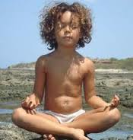
Self-regulation
“The better a child can stay calmly focused and alert, the better he integrates the diverse information coming in from his different senses, assimilates it, and sequences his thoughts and actions.”

Slide 25
HELPING TEENS SELF REGULATE
Don’t isolate … encourage teens to use their social network
Exercise …. Particularly cardio activities
Sleep …. Turn off your devices and get plenty of rest!

Slide 26
Relaxing Helps reduce Anxiety
TENSE AND RELEASE:
Sitting in a chair, arms hanging down, put up with your arms. Hold for 5 sec. and repeat
Sitting in a chair scrunch your face tight for 5 sec. Repeat.
Next tense your lower body include your back and stomach. 5 sec. twice
Now your whole body 5 sec twice

Slide 27
Relaxing Techniques
IMAGERY: Close your eyes. Take three deep breaths and recall a place that is very safe for you. A place that you can totally relax and be yourself. Notice the scenery, how it feels to be in your body, your emotion. Now with your eyes remaining closed and staying in your safe place take your left hand and squeeze your right wrist. Repeat the squeeze hold for 5 seconds. Open your eyes squeeze and notice the effect.

Slide 28
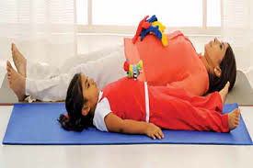
BELLY BREATHING
1.PUT ONE HAND ON YOUR BELLY AND THE OTHER ON YOUR CHEST.
2. BREATH IN ANDOUT, NOTICE IF YOUR HANDS ARE MOVING
3. BREATH INTO YOUR UNPPER ABOMEN AND SHOULDERS.
3. BREATH IN FOR 7 SECONDS, THEN OUT FOR 9 SECONDS
4. REPEAT 2 – 4 TIMES

Slide 29
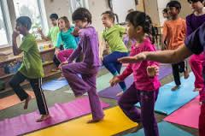
GROUNDING AND BALANCING
Pressing your heels into the floor
Very slowly lifting your left foot up and then slowly lowering your foot.
Very slowly lifting your right foot up and slowly lowering your foot.
Repeat for 2 to 3 minutes, alternating your feet.

Slide 30
GROUNDING AND BOUNDARIES
Cross your arms putting your left hand over your right arm, and the right hand over your left arm.
Very slowly lift your left hand and slowly return and then slowly lift your right hand and slowly return.
Repeat for three to five minutes

Slide 31
SELF- TALK: Moving from irrational to rational more positive
Irrational self-talk: “ Must be popular”, or “I should get an ‘A’
Leads to Irrational Emotion: Anger, fear, panic etc.
Change the irrational or negative thoughts to more optimistic self-talk

Slide 32
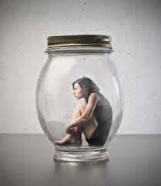
How Anxiety Persists, Staying Stuck
Same worry keeps returning
The fear is convincing. You believe the voice of fear
The fear stirs old memory.
Fear Leads to silence. From Shame and Guilt we don’t speak our fears
Shove it down, what you resist, persists.

Slide 33
Repetition makes the fear stick to the brain, So ……….
SELF-TALK:
I’m doing it again
I feel bad when I worry
I need to stop at this moment
The future is unknown. Worrying about it is pointless
I’m doing myself no good.

Slide 34
The Fear is Convincing, so ………
SELF-TALK:
Nothing bad is happening to me. I can handle the situation
I am not alone. I can turn for help if I need it.
My anxiety is just a feeling
Does this feeling make sense?

Slide 35
The Fear Stirs a Memory, so…….
SELF-TALK:
This feeling is how I felt a long time ago.
What could I feel now that fits the situation better?
All that I’m scared of is a memory. ( The past is over. G,W. Bush)
What’s actually in front of me?

Slide 36
Fear Leads to Silence, so………..
SELF-TALK:
I don’t want to live with my guilt
Silence is making it worse
No matter how long I wait, my anxiety isn’t going away on its own.
The truth has the power to set me free

Slide 37
You shove the pain out of sight, so……………….
SELF-TALK:
I know I am hiding something, and it hurts
It’s scary to come clean, but that’s how I heal.
I want to be unburdened
Being haunted makes me too anxious
I am not going to die, no matter how scary this is.
The more I face fear, the more control I gain over it

Slide 38
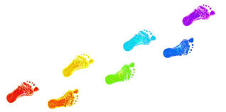
Taking Baby Steps when fearful of something, snakes, spiders, open spaces
Desensitization Approach: “ Fear of losing mommy.”
Dad and mom together at home
Dad and mom home, and mom goes out in the afternoon
Dad stays home with the nanny/auntie, mom out for the day
Auntie/nanny is home with the child.

Slide 39
“Children need encouragement like a plant needs water” Driekurs
Encouraging and Acknowledging Brave, Nonanxious Behaviour
Encouraging the Child to Cope Constructively: Helping the child acknowledge their fear, encourage him to come up with ways of coping.

Slide 40
ENCOURAGEMENT
ENCOURAGEMENT: is the total acceptance of the person as they are, regardless of their lack of skills and ability.
“Children need encouragement the same way a plant needs water.”
Rudolph Dreikurs

Slide 41
Praise versus Encouragement
PRAISE ENCOURAGEMENT
____________________________________________________-___________________________________________________Focus external Control Focus on child’s ability to manage life constructively
Focus external evaluation Focus on internal evaluation
“Good Work” “Great student”
Self-worth based on Self-evaluation.
0ther’s opinions “What do you Opinions think about your work?
”Child learns to conform or rebel Person learns courage to be imperfect
Focus on self elevation Focus on assets,
personal gain contribution, appreciation

Slide 42
Methods of Encouragement
Focus on strengths and abilities
Acknowledge effort and improvements
Make every effort to eliminate criticism
Accept the student’s feelings. Truly listen to students
Recognize contributions
Show faith in the child
Encourage the child to self-assess

Slide 43
Methods of Encouragement Continued
Don’t feel sorry for the child
Don’t praise the child
Avoid bribery to control
Instill “The Courage to be imperfect.”
Look for opportunities to develop empathy
Don’t be to helpful, but provide scaffolding to assist
Teach kids to ‘care about the cares of others.’

Slide 44
ANXIETY IS REDUCED WHEN
EVERY CHILD IS:
CONNECTED
CONTRIBUTING
CAPABILE

Slide 45
Safety Mechanism
It the situation is deemed safe, then the Safety Mechanism is triggered. (Love without Fear) which allows the student to sustain focus.

Slide 46
Self-regulation
“The better a child can stay calmly focused and alert, the better he integrates the diverse information coming in from his different senses, assimilates it, and sequences his thoughts and actions.”

Slide 47
MINDFULNESS AND MEDITATION
Mindfulness Techniques take the attention to the present moment and away from the Future were anxiety lives. Produces theta waves in the brain
Meditation, TM in particular produces deep rest which dissolves deep rooted stress and strain. Produces Alpha waves.

Slide 48
Unhelpful Ways of Dealing with Anxiety in Children
Providing too much or too little reassurance. “everything will be alright”, “nothing to be afraid of” The more assurance you give the more they want.
Being too Directive: Micro-managing, taking over and directing the child.
Permitting or Encouraging Avoidance: As long as children continue to avoid they won’t overcome their anxiety
Becoming Impatient with Your Child: It is too easy to become impatient and frustrated with an anxious child.

Slide 49
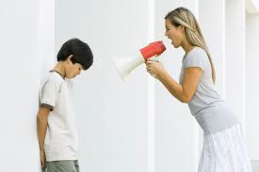
Seven Habits of External Control that Destroy Relationships
Blaming
Complaining
Criticizing
Nagging
Threatening
Punishing
REWARDING TO CONTROL
William Glasser

Slide 50
QUESTIONS AND ANSWERS

Slide 51
THANK YOU!
You can download this Power Point at:
www.adlercentre.ca OR
Email: apabc@adler.bc.ca
AnxietyBC: a useful website

